Slide 1
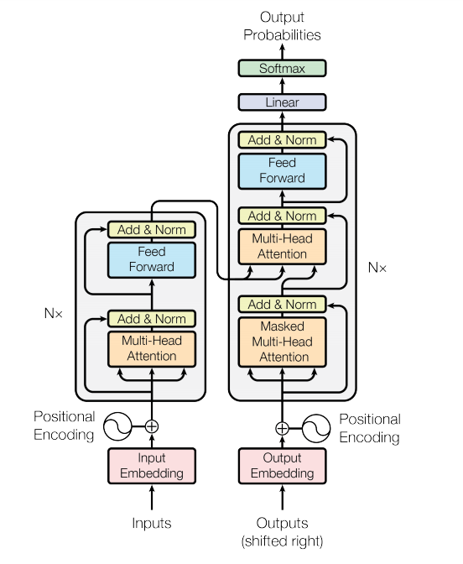
Transformers
Attention All You Need

Slide 2
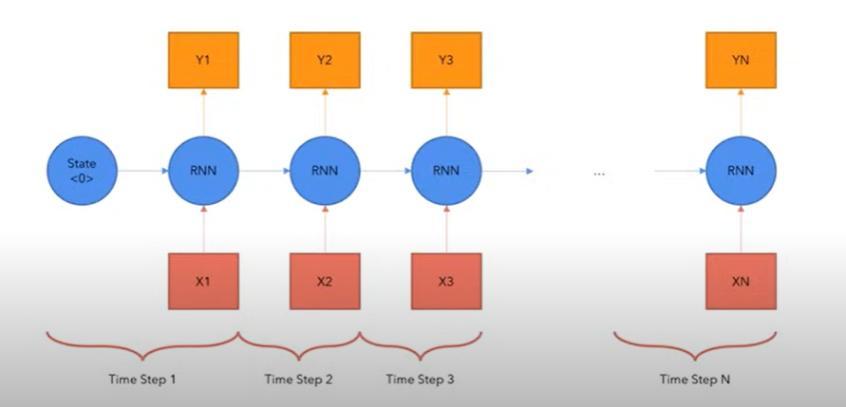
Limitations of Previous Models
RNNs/LSTMs → sequential, slow, hard to parallelize
CNNs → better parallelization, but weak at long-range dependencies
NOTE: Transformers key idea is to remove recurrence & convolutions. Use only attention

Slide 3
Transformer Architecture
Encoder and Decoder Stacks
Encoder
Decoder
N =6 layers
N =6 layers
Notes:
The structure of the transformer, we divide it into two micro blocks.
The first part, Encoder: left
The second part, Decoder: right
Connected such that the information from the encoder send to the decoder.

Slide 4
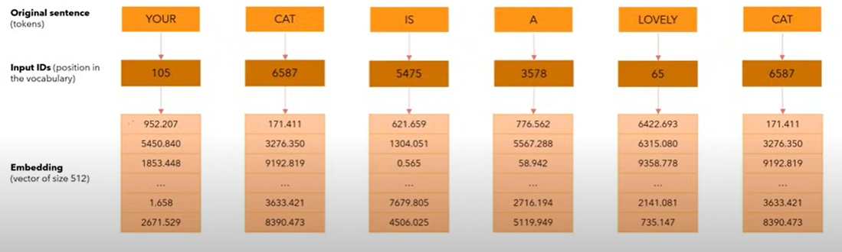
Input Embedding
Notes:
Input sentence — token
Input ID: Number — position in the vocabulary
Input ID – input vector, embedding.
We define d mode = 512 which represent the size of embedding vector of each word.
Input ID will not change but input embedding will change according to the loss function.
Our model will learn to change the number in the embedding vectors in such a way it represents the meaning of the word. It is basically a mapping from single word to a mapping to 515 vector.

Slide 5
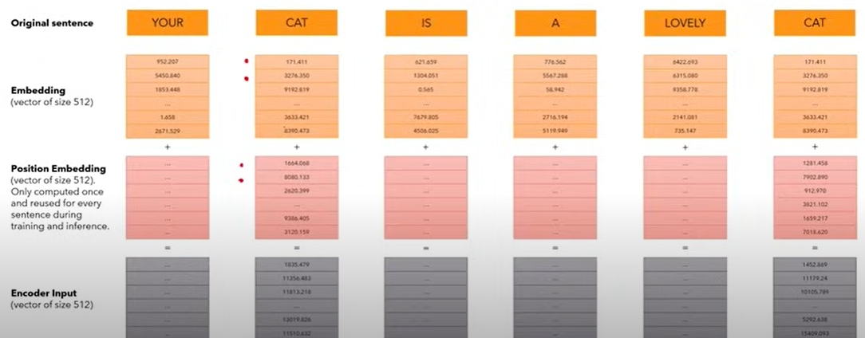
Positional Embedding
Notes:
We want that each word to carry the information about its position in the sentence.
We want the model to treat words that appear close to each other “close” and words that are distant as “distant”
We want positional encoding to present a pattern that can learned by the model.
After creating the embedding vectors, we add another vector (positional vector). It is fixed and not learned. This vector represent the position of word in the sentence. It gives the output of vector of size 512.

Slide 6

Positional Embedding
For each position we calculate the value using these two expressions,
pos = position, i = 0, 1, …, 512
Note: We only need to compute positional encoding once and reuse them for every sentence, no matter if it is training or inference.

Slide 7
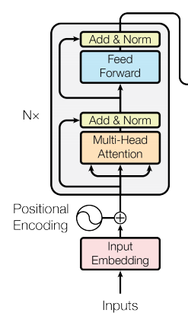
Encoder

Slide 8
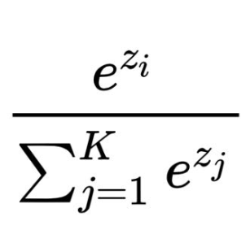
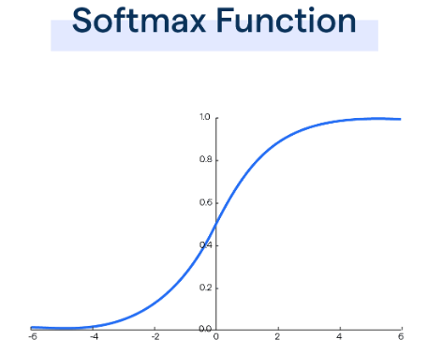

What is Self-Attention?
Mapping a query Q and set of Key-Value pair (K,V). Self-attention allows model to relate words with each other.
Notes:
Exit before transformer, transformer changed it into multi head attention.

Slide 9

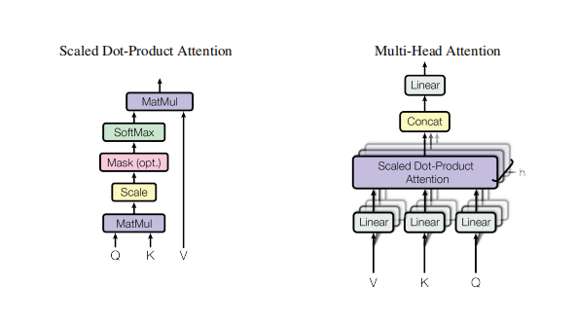
Multi-head Attention
Types of Attention
Dot product(multiplication) attention
Additive attention

Slide 10
Application of Attention in Model
Encoder-Decoder Attention
Encoder contains self-attention layer.
Decoder contain self-attention layer.

Slide 11
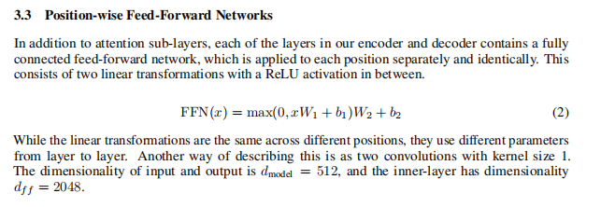
Feed Forward Network

